Slide 1

AGILE METHODS KANBAN & LEAN

Slide 2
Table of Content
1- What is KANBAN
1.1 KANBAN and it’s history
1.2 KANBAN Principles
1.3 KANBAN Practices
1.4 KANBAN board
1.5 KANBAN vs SCRUM
1.6 Pros & Cons
1.7 when to use KANBAN
2- What is LEAN
2.1 LEAN and it’s history
2.2 LEAN Manufacturing Wastes
2.3 LEAN Manufacturing Principles
2.4 LEAN Software Development Principles
2.5 LEAN vs SCRUM
2.6 Pros & Cons
2.7 when to use LEAN
3- What is Trello
1.1 Trello website overview
1.2 Trello Board overview

Slide 3
What’s KANBAN ..?
1

Slide 4
KAN + BAN
看 板
=
Sign Board

Slide 5
KANBAN and it’s History
1.1
KANBAN :
One of AGILE frameworks designed to help you to visualize your work
Make you and the team member understand the workflow better
work items visually represented on board to allowing team to see the state of work at any time.

Slide 6
KANBAN and it’s History
1.1
KANBAN history :
Invented at Toyota after second world war.
Based on how the supermarkets shelf-stocking system
due to that the customer demand may change over time they work to product a items as the required not more.
To control the production flow they uses a cards as a visual signals using a paper and the system called “KANBAN”.

Slide 7
KANBAN Principles
1.2
Start with what you know:
Don’t change your work right away changes must be applied gradually over time and at a pace of the work flow of the team
Agree to pursue incremental, evolutionary change:
make small changes incrementally rather than make large changes.
Respect the current process:
Don’t make changes without agreement from all of the team members.

Slide 8
KANBAN Practices
1.3
Visualize the flow of work:
Based on you can’t understand what you can’t see.
Visualize the work on board filled with cards (physically, digitally).
Work-in-progress (WIP) limit:
Forcing team member to be focus in particular tasks to get more done and do it better.
Great way to see the work needing to be done
Enhancing workflows:
Helps the team to improve the flow and reduce the time of do work.
Make to work more effective.

Slide 9
KANBAN Practices cont’d.
1.3
Create explicit policies of the process:
Formulating explicit guidelines for all who will participate on work.
Make the participants know how to do any type of work.
Implement feedback loops:
Important part of any system allows you to get feedback from the participant about work progress and flow to evaluate the process.
Data driven improvement:
Changes on the work must occurs based on scientific method not based on felling.
Make to work more effective.

Slide 10
KANBAN boards
1.4
It’s a tool used to make the work visual and help team to manage the workflow
Elements of Kanban board:
Visual signals :
It’s a card which represent a work item called “KANBAN CARD”
Columns :
Represent the activity or the state of set of cards
WIP Limits :
It’ describes the maximum number of cards that can be at the same column

Slide 11
KANBAN board cont’d.
1.4
Board types:
Physical Board:
It’s a simple Kanban board it implemented physically on white board and help team to demonstrate the workflow
Advantage of it that it always open didn’t closed didn’t rolled.
Digital Board:
Digital extension of Kanban board help teams to share to work flow even if the didn’t they don’t at the same office
Trello is one of digital boards.

Slide 12
KANBAN vs SCRUM.
1.5
Roles:
Scrum :
There is a scrum master , product owner.
Kanban :
There is no roles , it any help is needed it requested from agile coach.
Key metric:
Scrum :
Velocity : calculated by counts the number of completed user story at the end of sprint.
Kanban :
Cycle time : the time between starting of the task and the end of it

Slide 13
KANBAN vs SCRUM cont’d.
1.5
Deal with changes:
Scrum :
Should not to make changes to the sprint during it .
Kanban :
Change can be at anytime.
Releasing methodology:
Scrum :
When the sprint is ended if the product owner approve it.
Kanban :
When the team want or continuous delivery

Slide 14
KANBAN vs SCRUM cont’d.
1.5
Cadence :
Scrum :
Sprints have a clear start and finish dates usually be from week to 4 weeks
Kanban :
It based on continuous workflow that make team ready to any changes

Slide 15
Pros & Cons
1.6
Advantages:
Visualize the work make the problems easy to identify.
Evaluates the impacts of changes
Work at the pace of the team member
Reduce waste of work and time
WIP limits help team to focus on specific jobs
Identify bottlenecks and avoid it

Slide 16
Pros & Cons cont’d
1.6
Disadvantages:
Demand changes may cause problems.
Continuous workflow make prediction of timelines of the project difficult
Not good if the change is radical in the system

Slide 17
When to use
1.7
KANBAN is required by teams when they work on projects with a lot of incoming requests and changes
Good with continuous flow processes like support

Slide 18
What’s LEAN ..?
2

Slide 19
LEAN and it’s History
2.1
LEAN :
Philosophy and set of principles that focus on maximizing value and minimizing waste in business processes.
The lean principle sees waste is anything that doesn’t add value that the customers are willing to pay for.
The goal of lean is to create more value for customers with fewer resources

Slide 20
LEAN and it’s History
2.1
LEAN history :
The concept of lean began in the 16th century in Venice, by fishermen who produced interchangeable pieces for boats.
The origins of lean can be traced back to Toyota.
In the 1980s, The term, lean manufacturing and its principles was detailed further by James Womack, Daniel T. Jones.

Slide 21
LEAN Manufacturing Wastes
2.2
Overproduction :
Producing more products than are needed, or producing them earlier than they are needed.
Overprocessing :
Adding unnecessary steps or features to a product.
Motion :
Unnecessary or inefficient movement of people or equipment.
Transportation :
Unnecessary movement or handling of materials or products.

Slide 22
LEAN Manufacturing Wastes
2.2
Inventory :
Excess materials or products that are not needed for current production.
Waiting:
Time spent waiting for materials, equipment, or information to be available.
Defects :
Products or services that do not meet customer requirements or that require rework.

Slide 23
LEAN Manufacturing Principles
2.3
Identify value :
Identify the value that your customers want and deliver it to them.
Map the value stream :
Map out the steps involved in creating value for your customers and eliminate any steps that do not add value.
Create flow:
Organize your processes to create a continuous flow of value, without interruption or delay.

Slide 24
LEAN Manufacturing Principles cont’d
2.3
Establish pull:
Implement a "pull" system in which demand drives the production process, rather than pushing products through the supply chain.
Seek perfection:
Continuously improve your processes and eliminate waste in order to create the maximum value for your customers.

Slide 25
LEAN Software Development Principles
2.4
Eliminate waste :
Identify and eliminate any activities or processes that do not add value to the end product or service.
Amplify learning :
Foster a culture of continuous learning and improvement, and use data and experimentation to inform decision-making.
Decide as late as possible :
Delay making decisions until the last responsible moment in order to Maximize the value of information.

Slide 26
LEAN Software Development Principles cont’d
2.4
Deliver as fast as possible :
Use agile and iterative approaches to deliver value to customers as quickly as possible.
Empower the team :
Encourage self-organization and empowerment within the team to promote creativity and efficiency.

Slide 27
LEAN Software Development Principles cont’d
2.4
Build integrity in:
Establish clear and transparent communication and processes to build trust and promote teamwork.
See the whole:
Take a holistic view of the development process, considering the interdependencies and relationships between different activities and teams.

Slide 28
LEAN vs SCRUM.
2.5
Scope :
Lean :
broad philosophy that can be applied to any business process.
Scrum :
specific framework for managing and completing complex projects.
Focus :
Lean :
maximizing value and minimizing waste.
Scrum :
delivering high-quality products in a fast and flexible manner.

Slide 29
LEAN vs SCRUM cont’d.
2.5
Time frame :
Lean :
long-term approach that involves continuous improvement over time.
Scrum :
involves short, iterative development cycles called "sprints".

Slide 30
Pros & Cons.
2.6
Advantages :
Improved efficiency and quality.
Saves Time and Money.
Increased customer satisfaction.

Slide 31
Pros & Cons cont’d.
2.6
Disadvantages :
Complexity.
Hinders Future Development.
Resistance to change.

Slide 32
When to use.
2.7
When you want to improve efficiency and reduce costs
When you want to improve quality
When you want to reduce lead time
When you want to increase customer satisfaction
When you want to increase competitiveness

Slide 33

Lets Talk about Trello
Trello is the most famous Kanban tool
Let us discover it together…

Slide 34
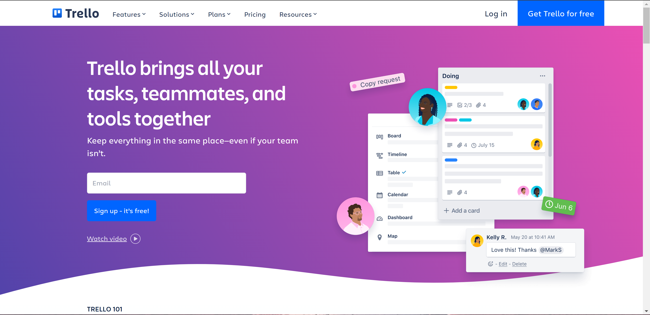
Home page overview
T

Slide 35
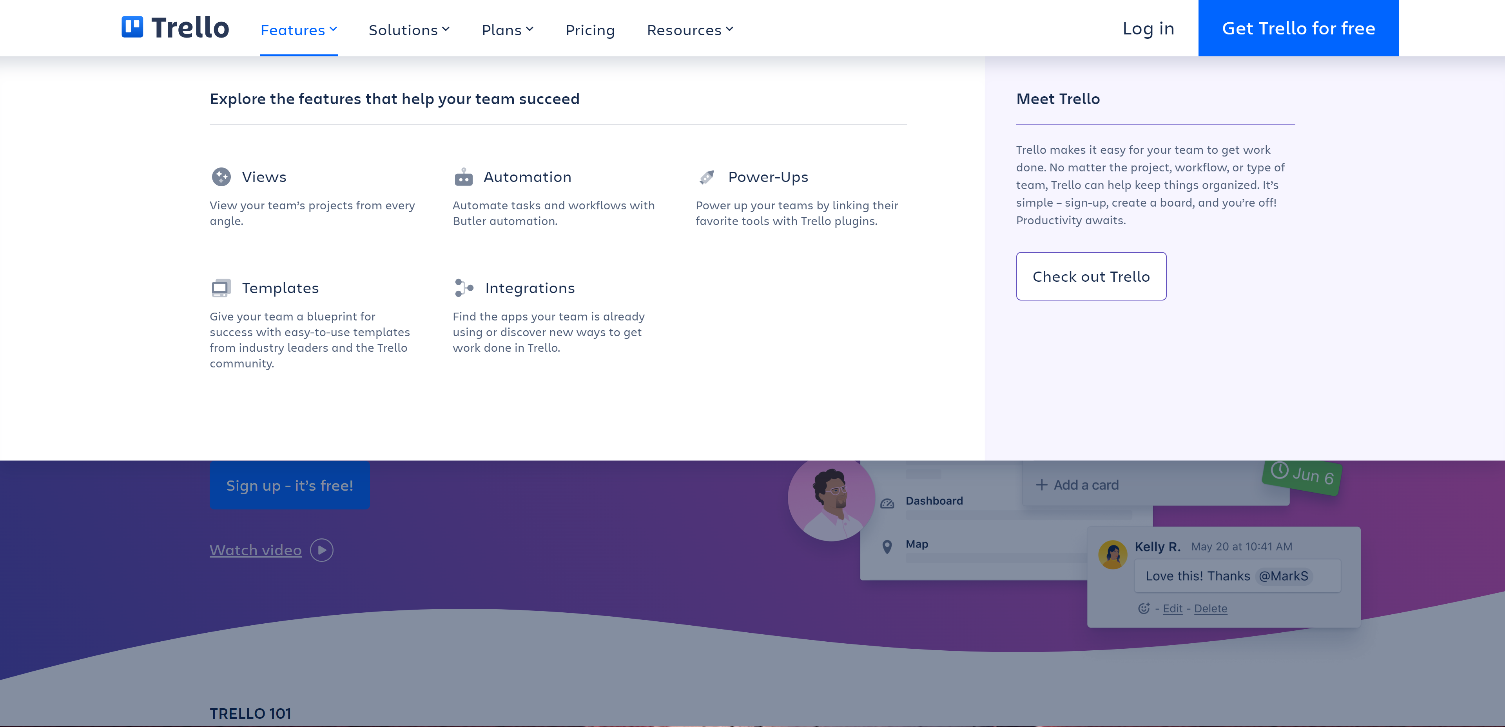
Trello Features
T

Slide 36
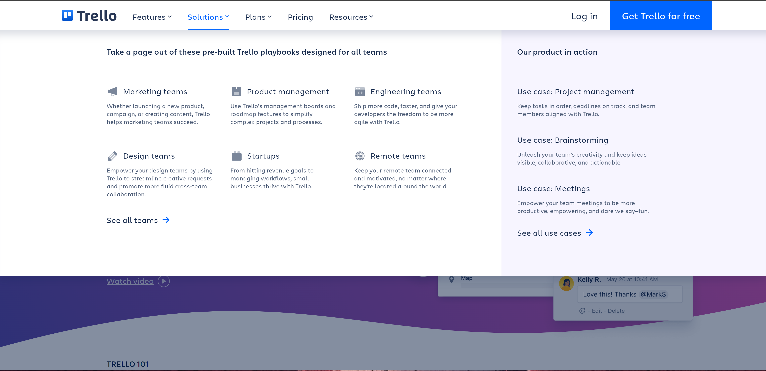
Trello Solutions
T

Slide 37
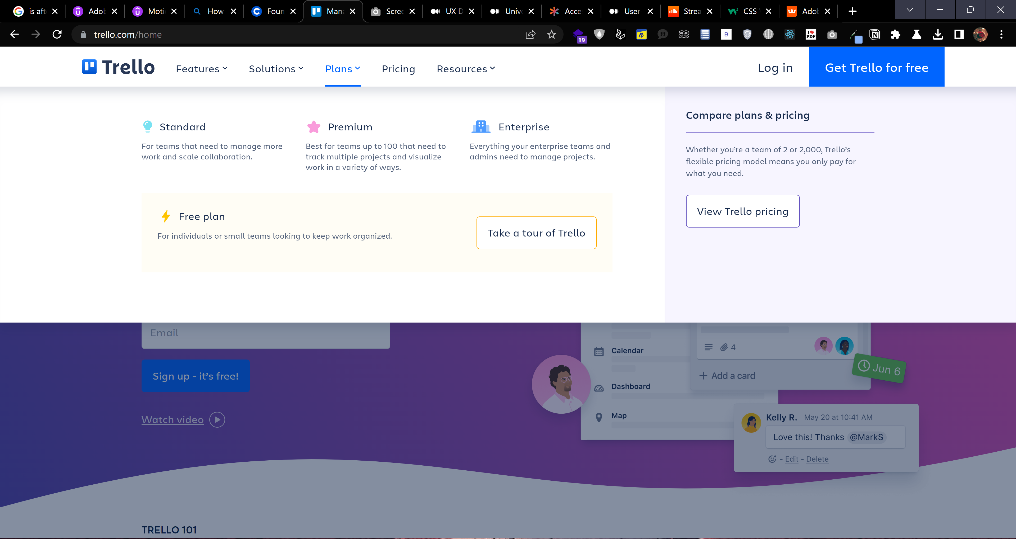
Trello Plans
T

Slide 38
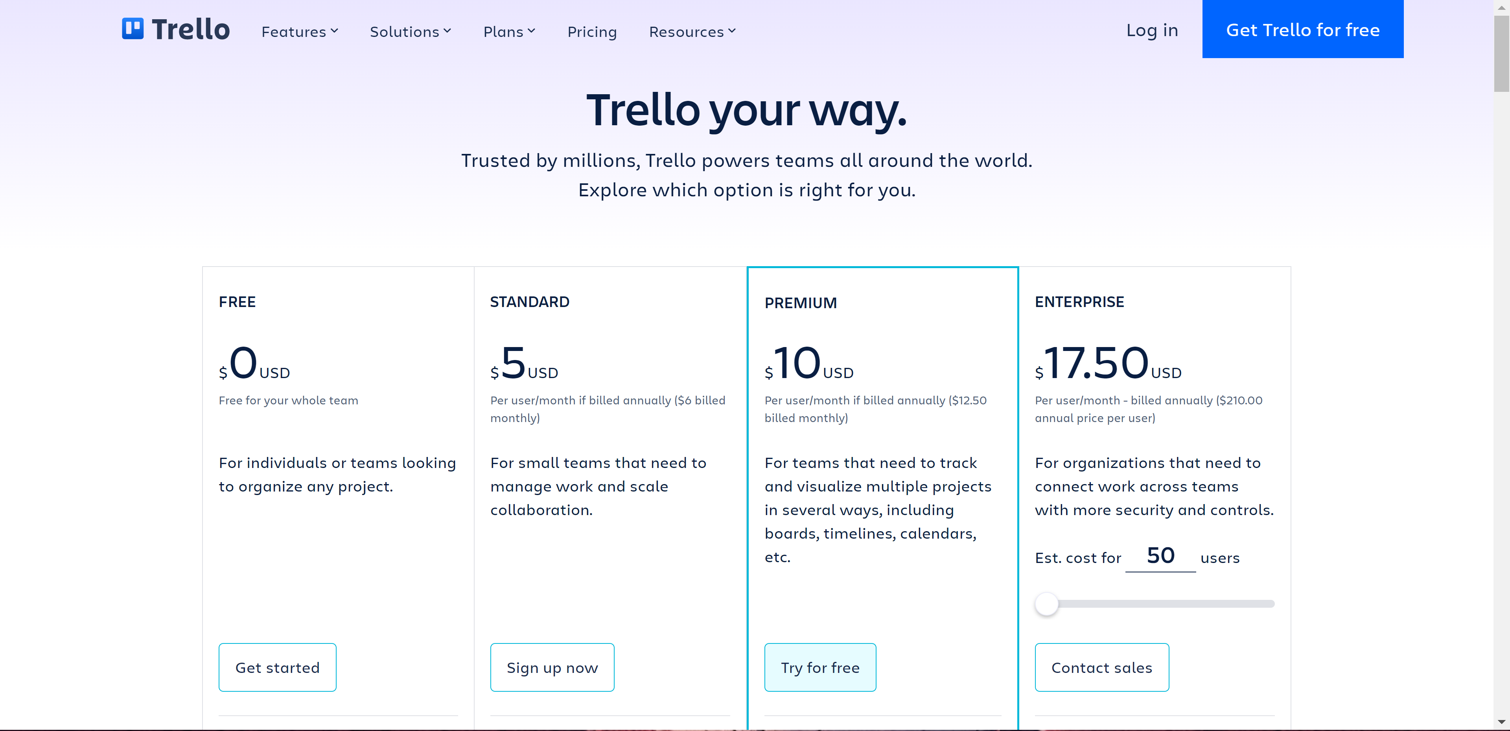
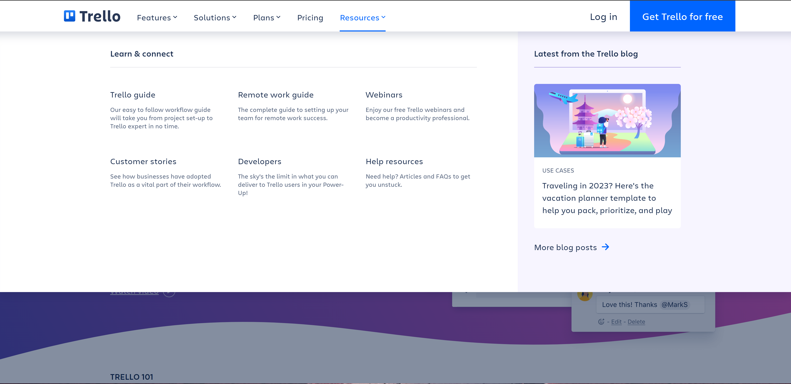
Trello Pricing
T

Slide 39

Trello Pricing
T

Slide 40
Trello Resources
T

Slide 41
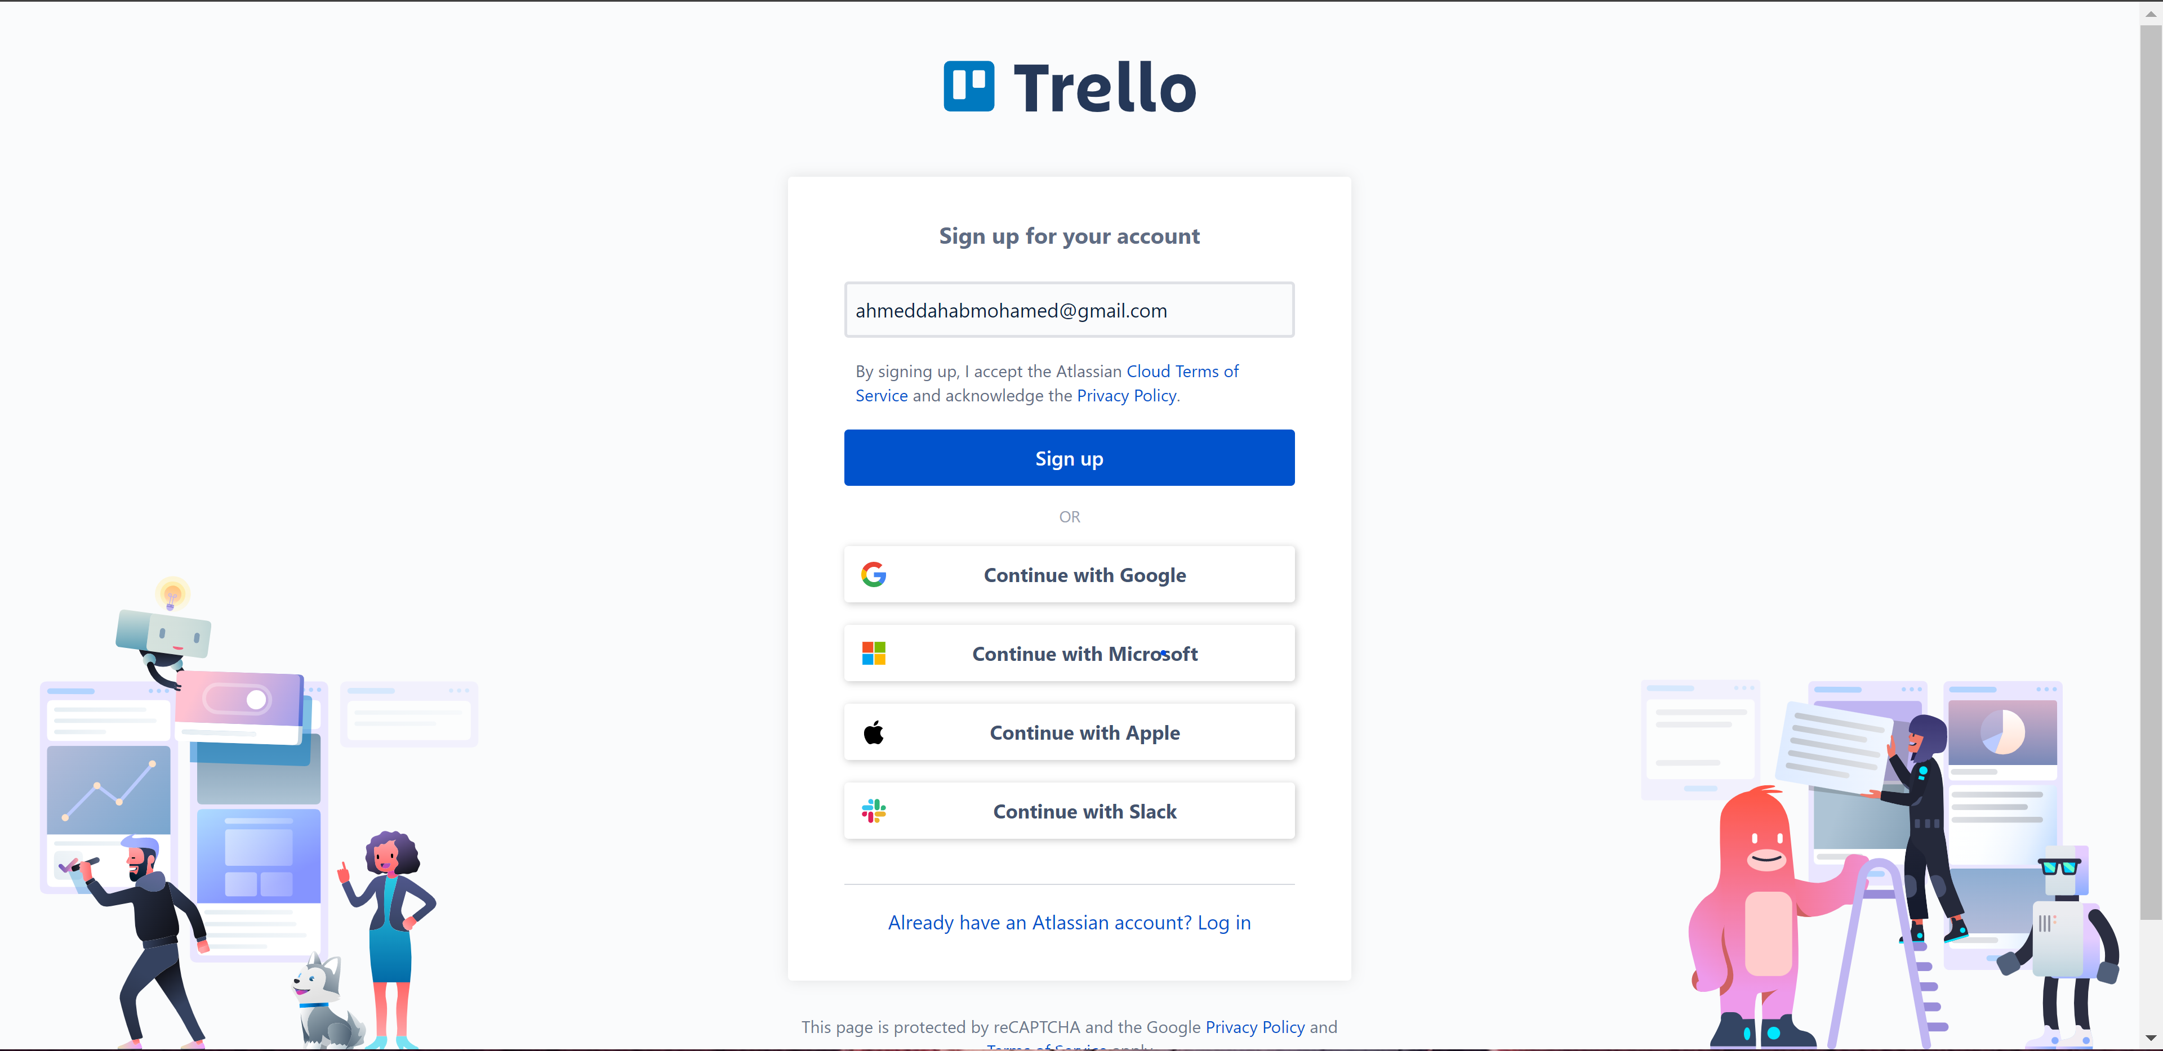
Trello Pricing
T

Slide 42
Trello Architecture
Work Space
Work Space
Work Space
Board
Board
10 Max
List
List
List
List
Card
Card
Card

Slide 43
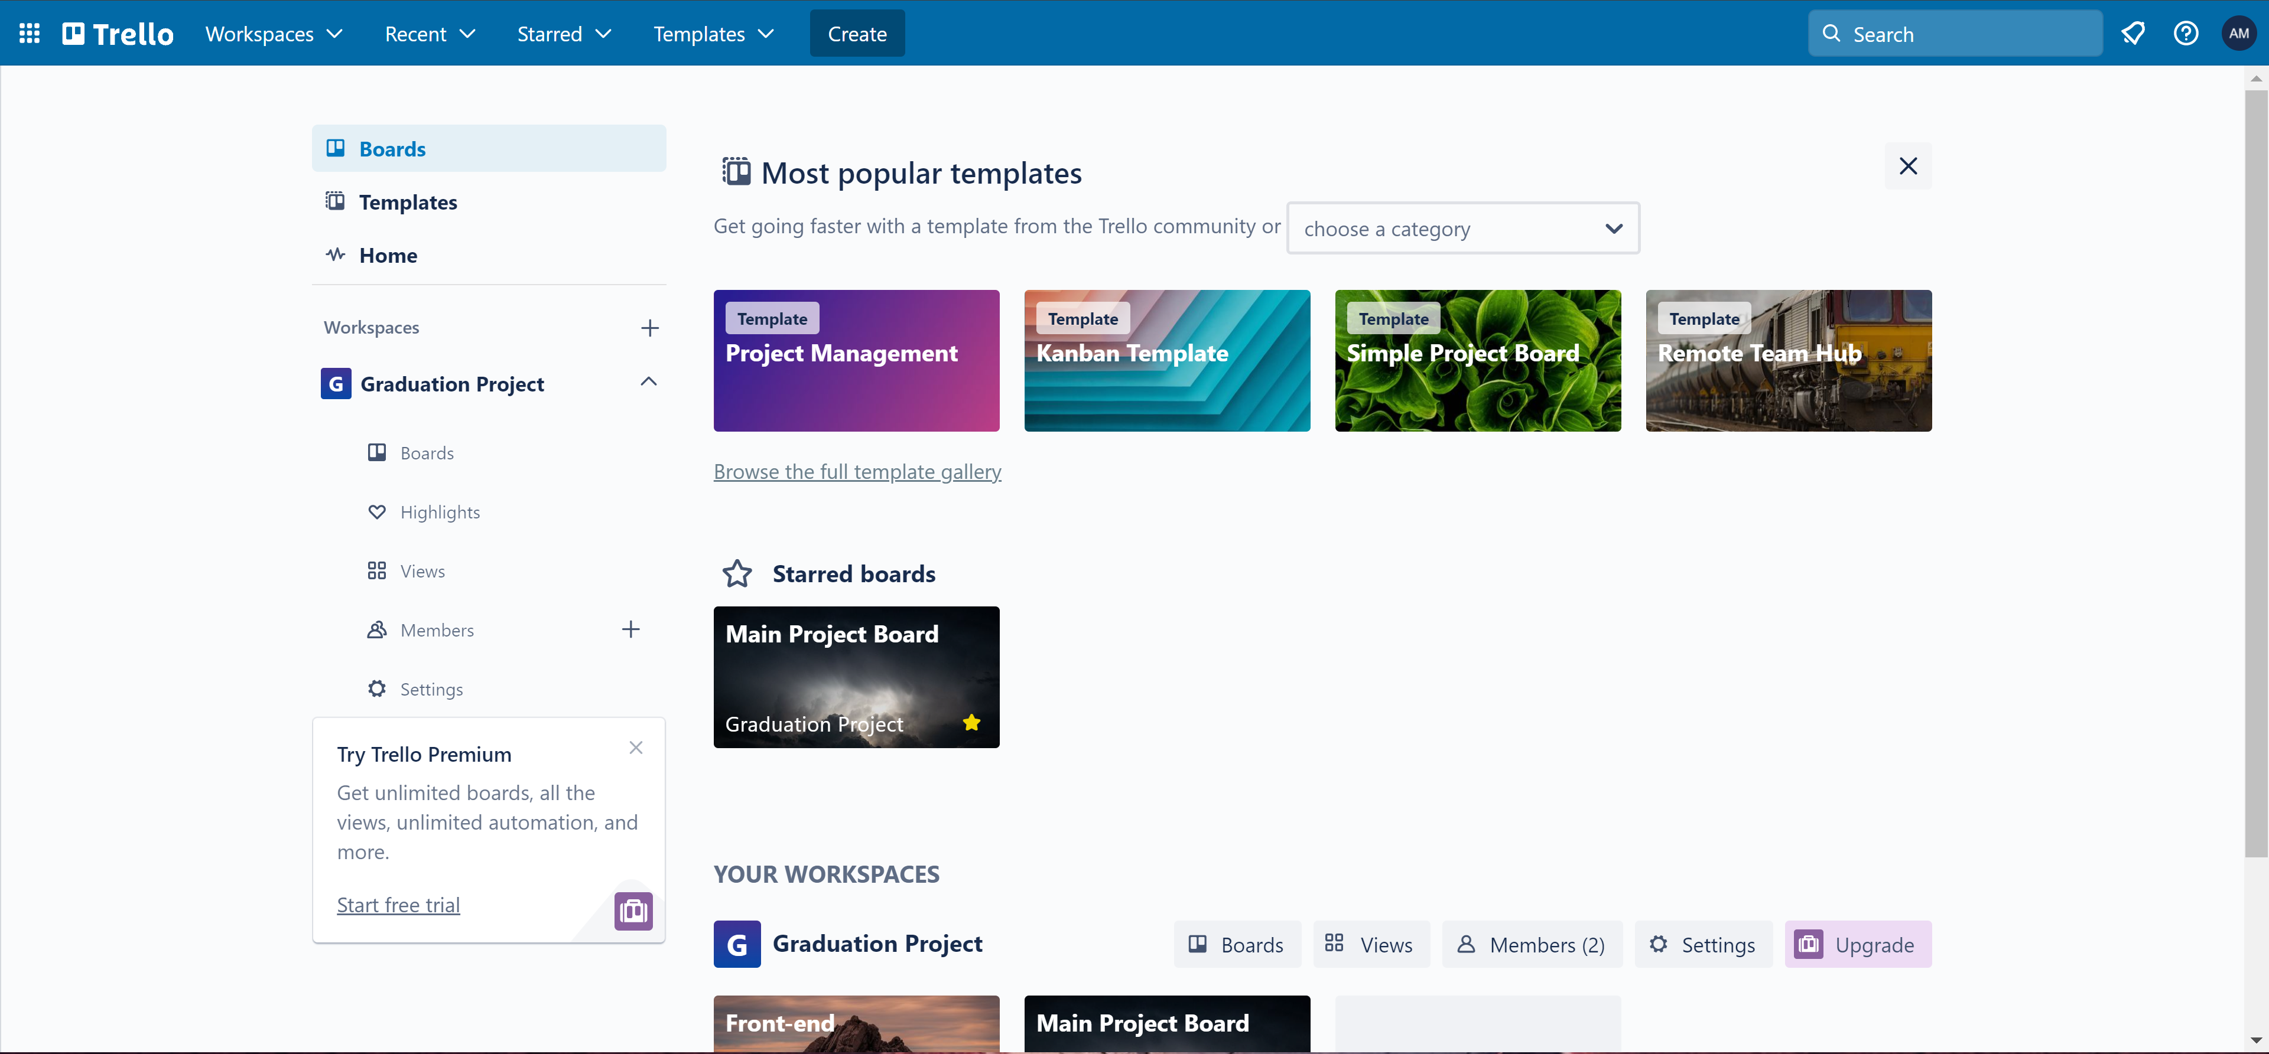
Trello User page
T

Slide 44
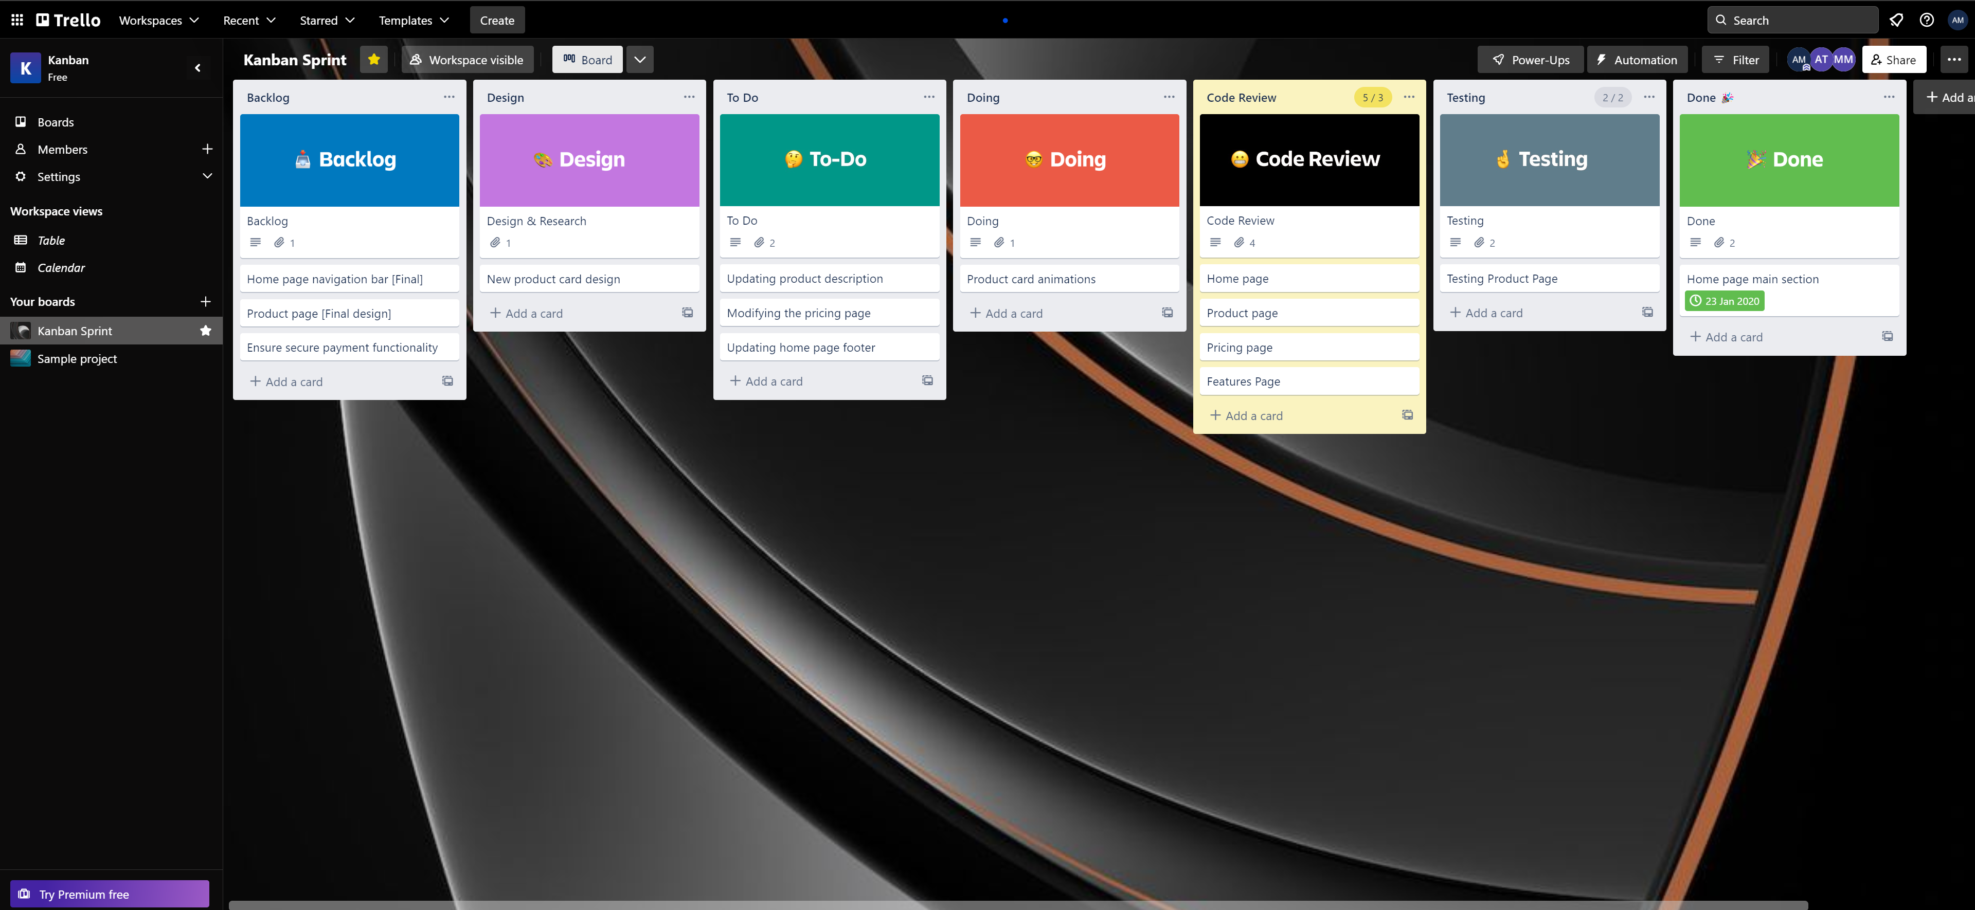
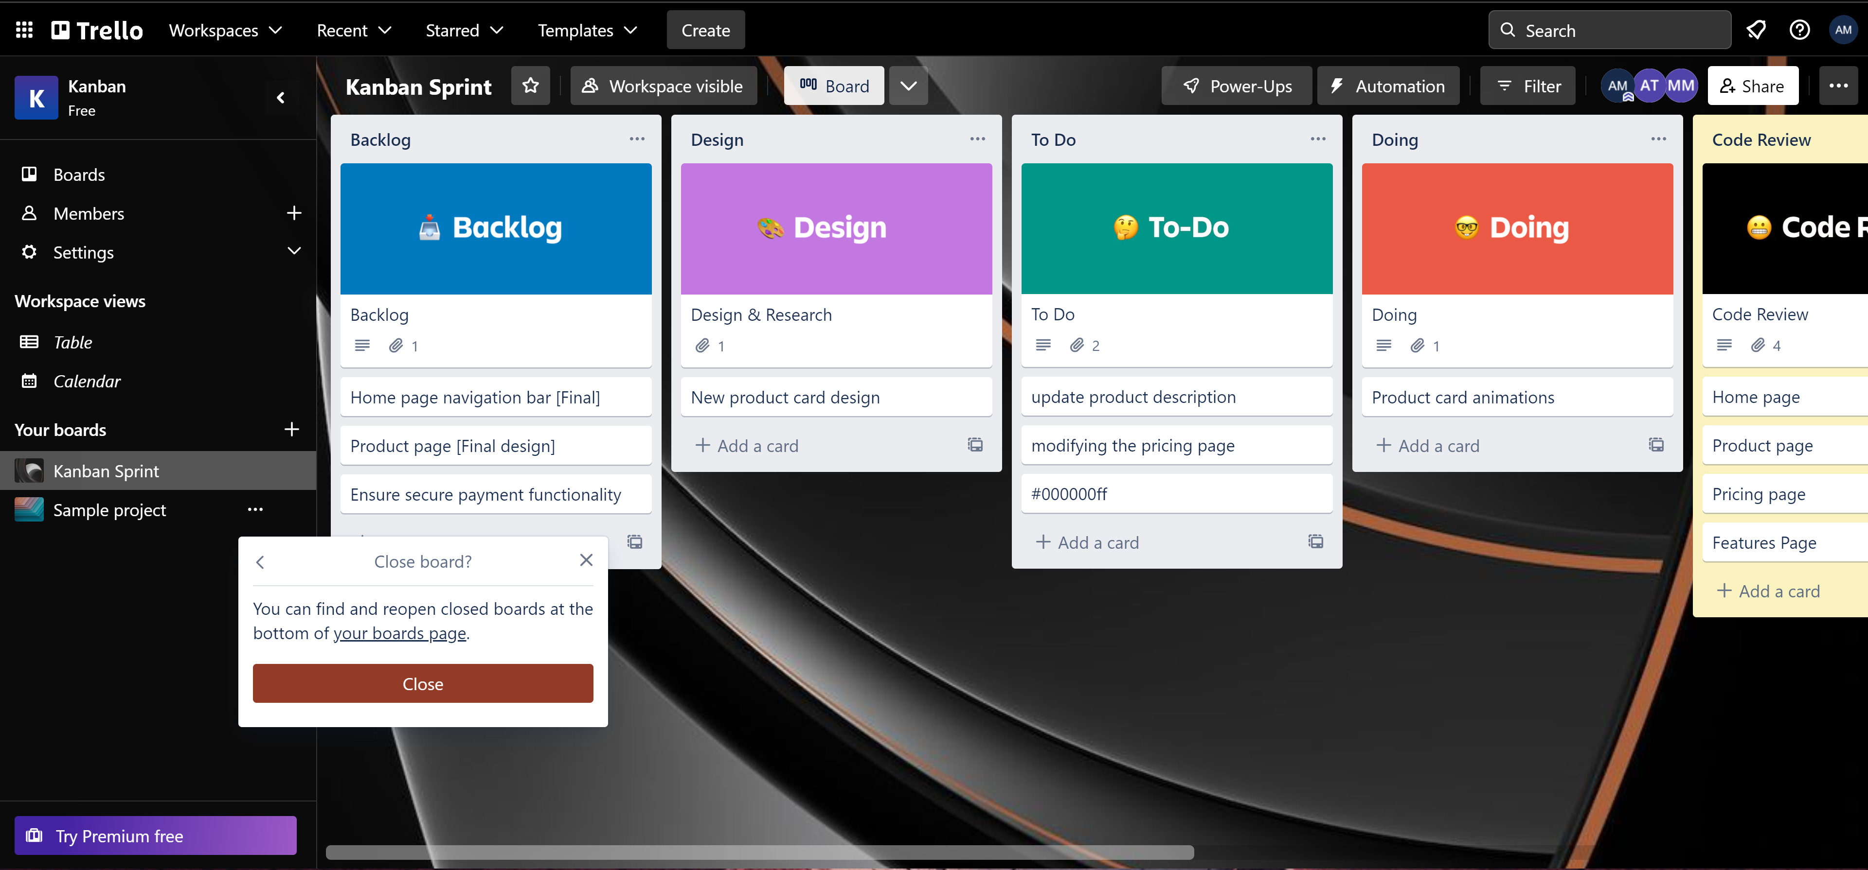
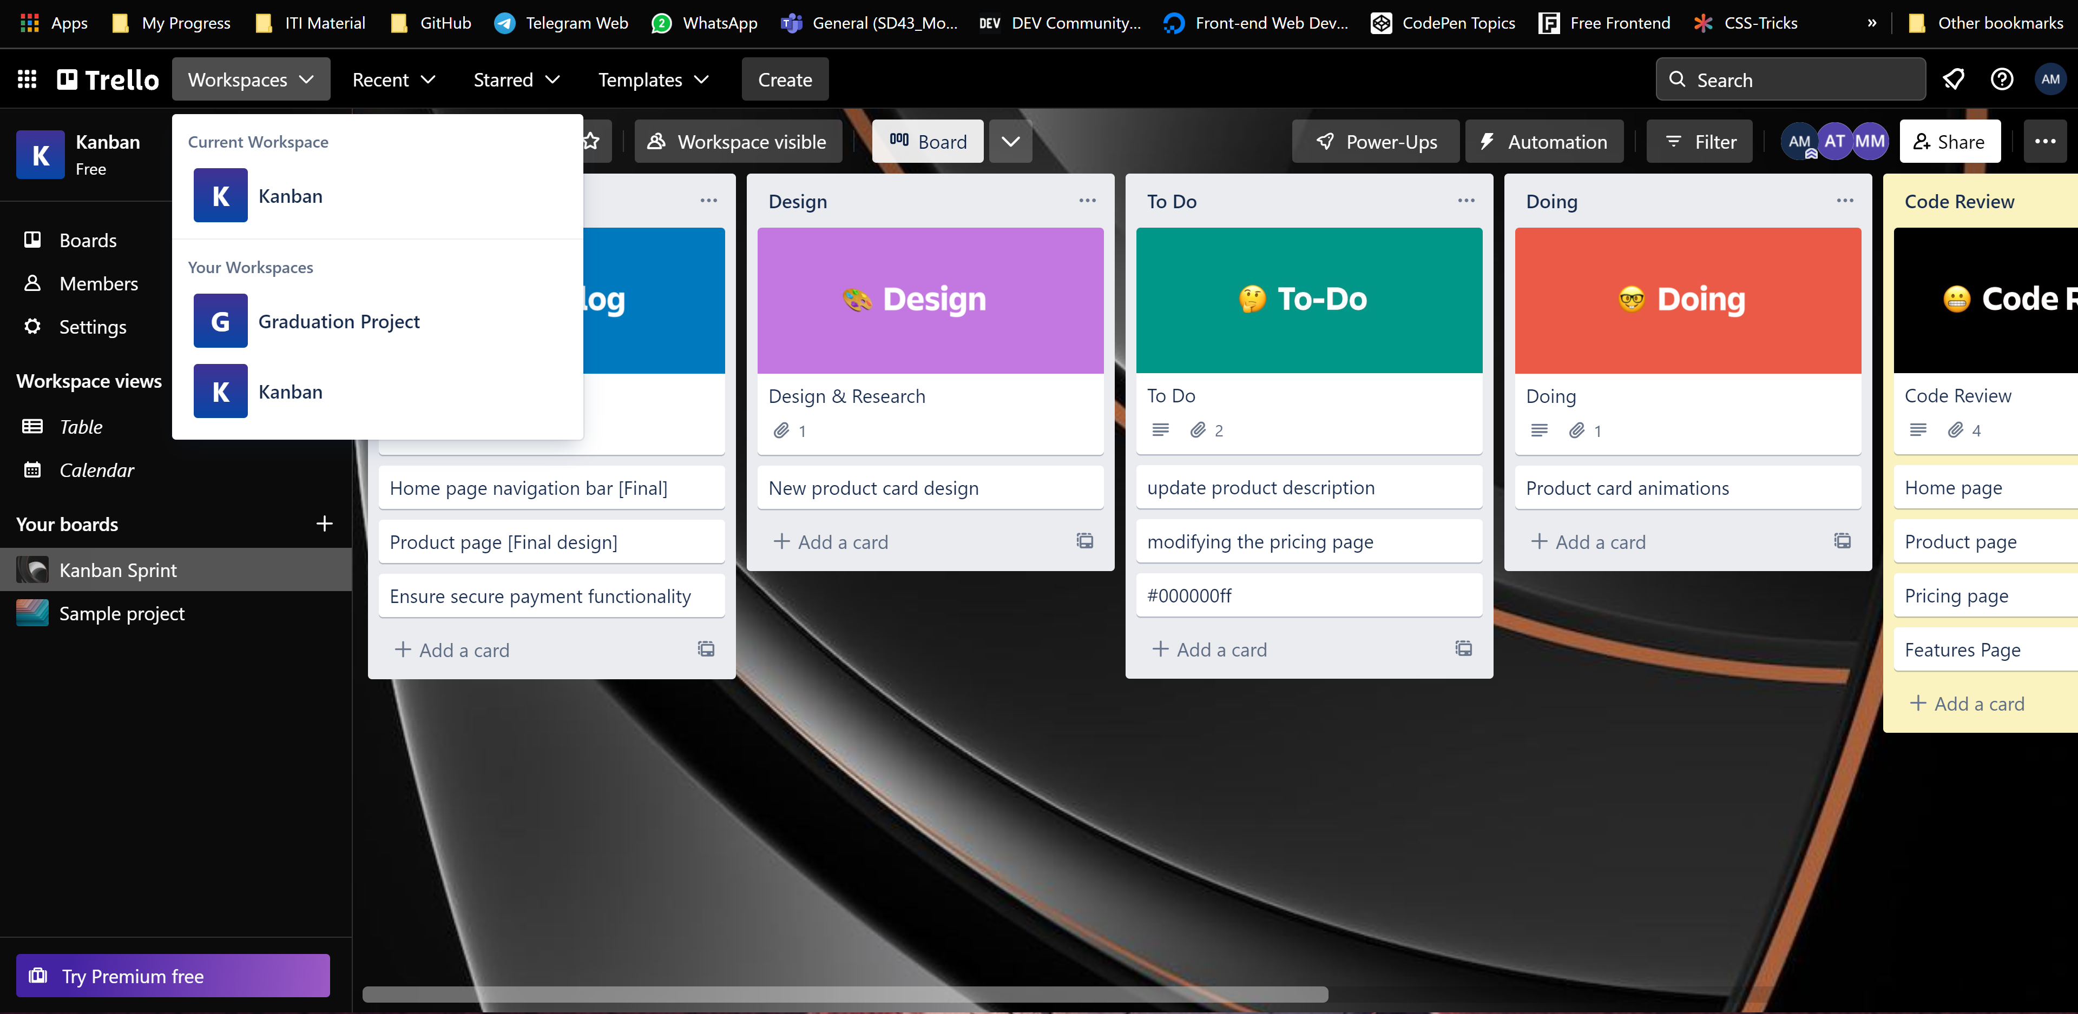
Trello Kanban Board
T

Slide 45
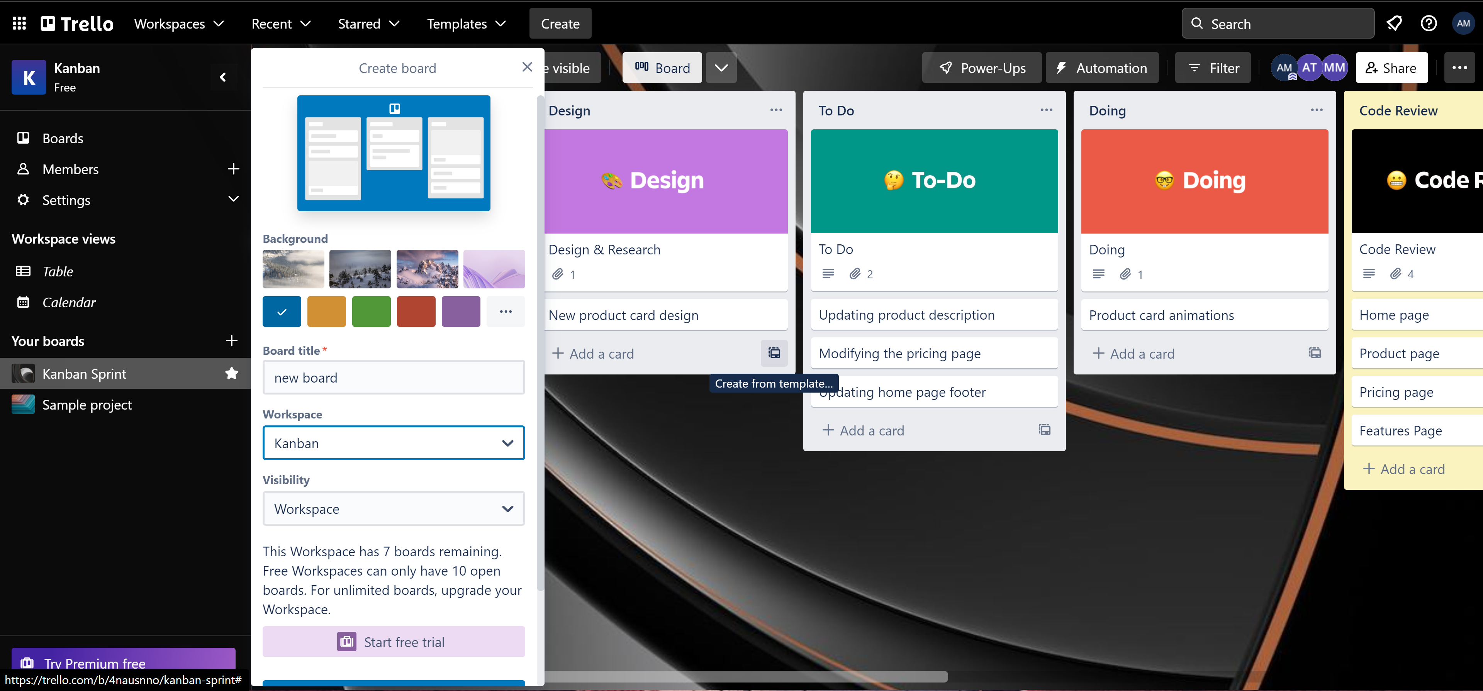
Trello create new board
T

Slide 46
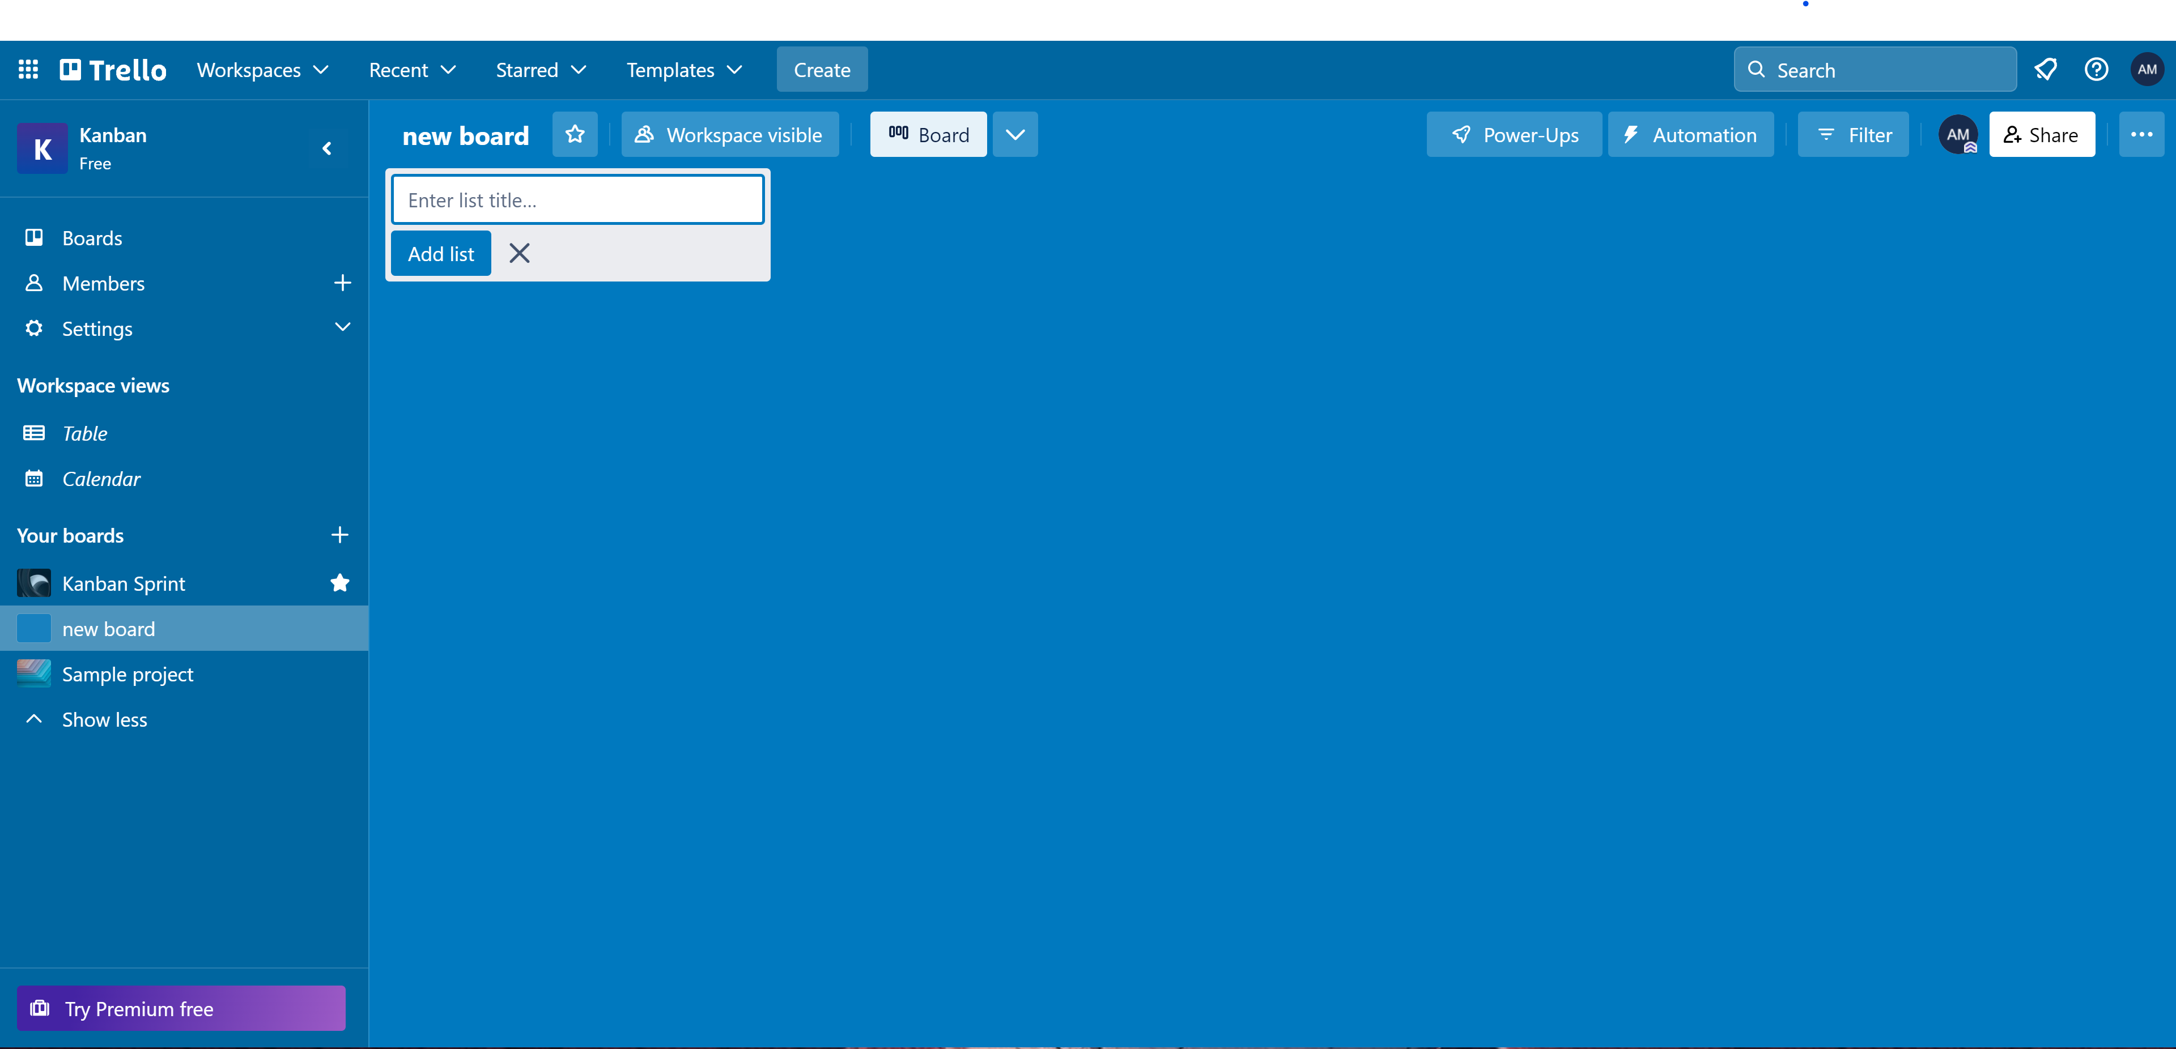
Trello New/Default Board
T

Slide 47
Trello Kanban Board
T

Slide 48
Trello Kanban Board
T

Slide 49
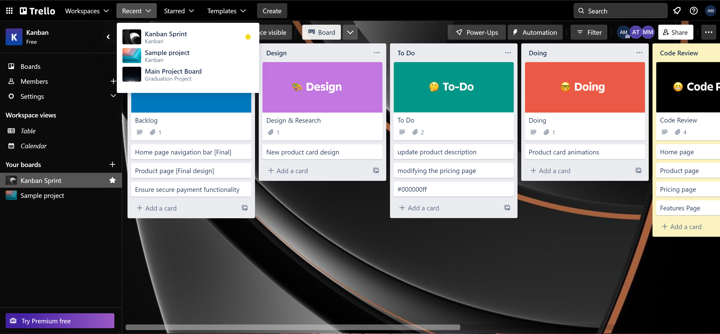
Trello Kanban Board
T

Slide 50
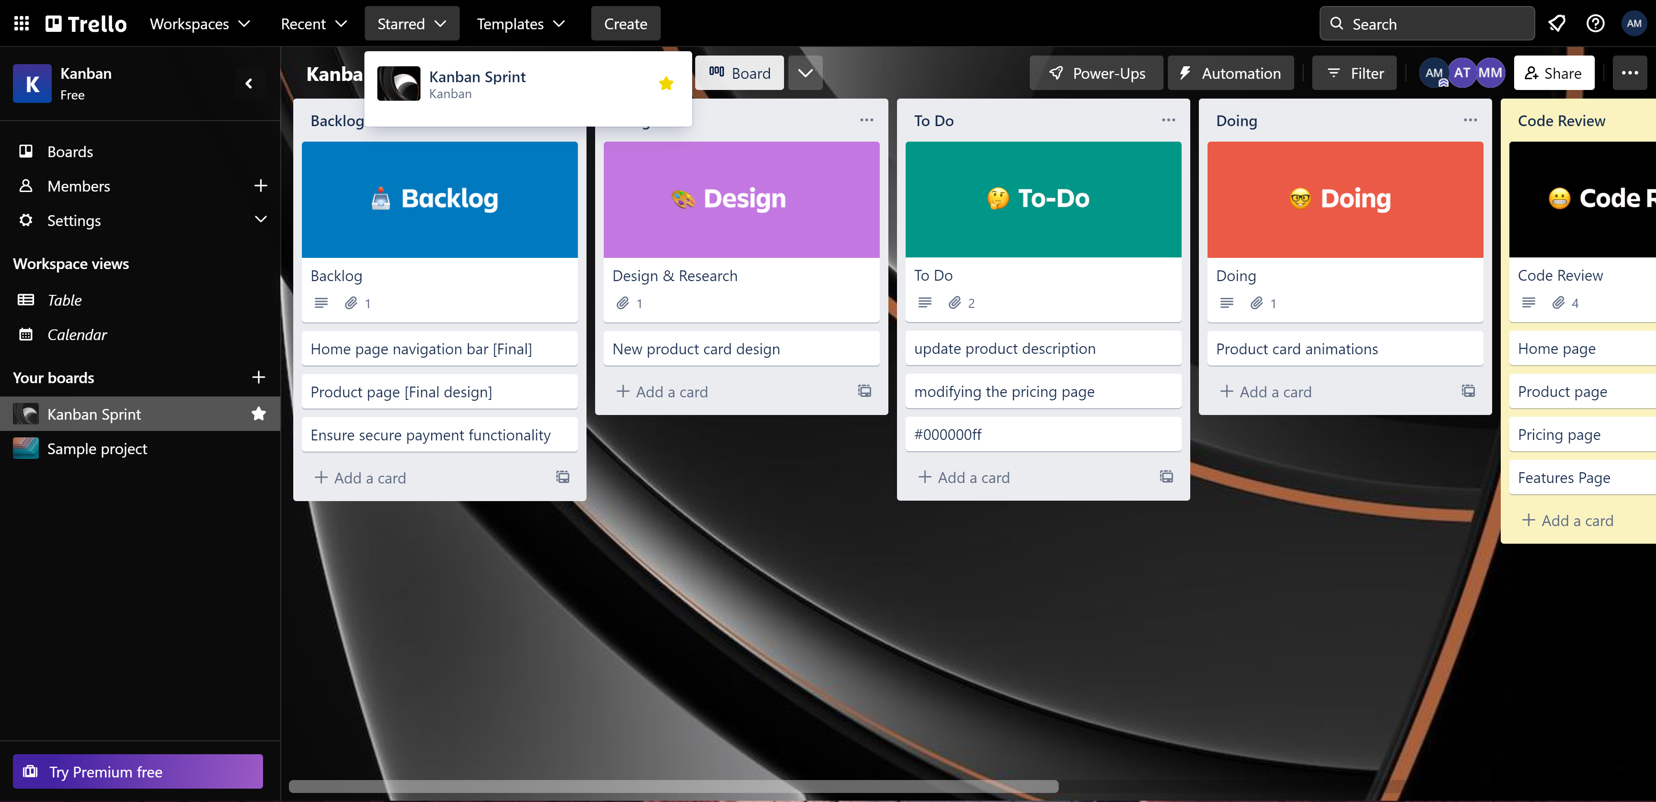
Trello Kanban Board
T

Slide 51
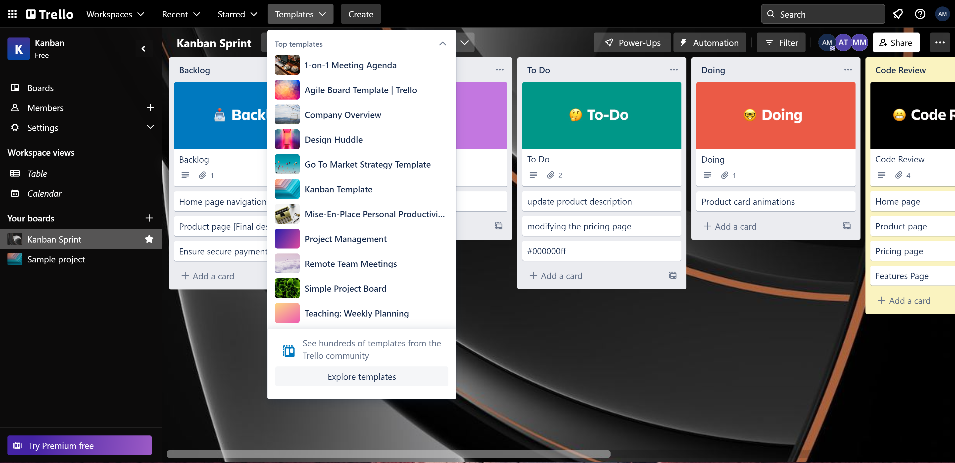
Trello Kanban Board
T

Slide 52
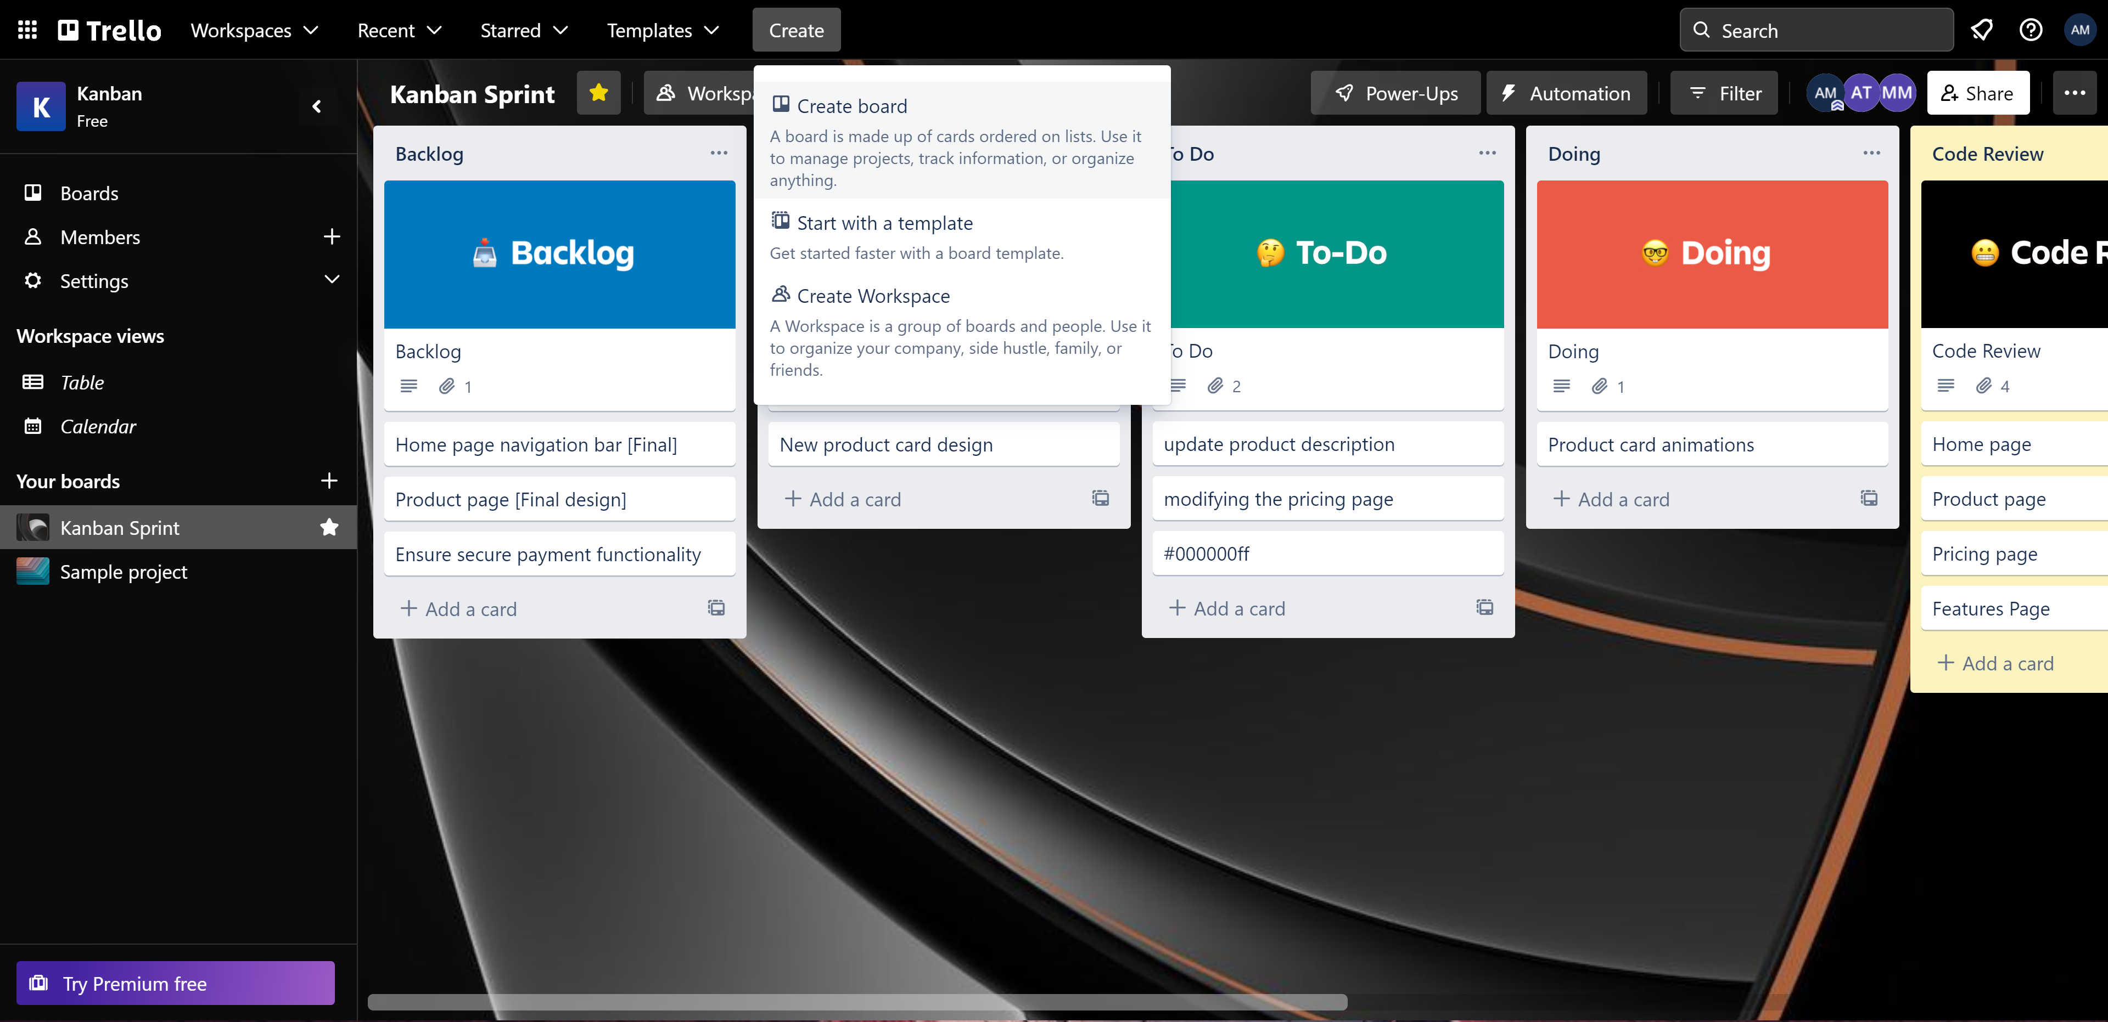
Trello Kanban Board
T

Slide 53
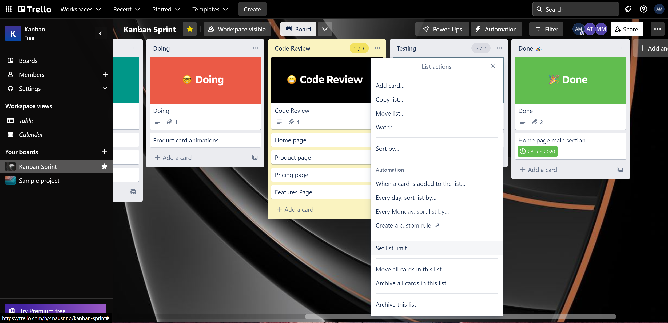
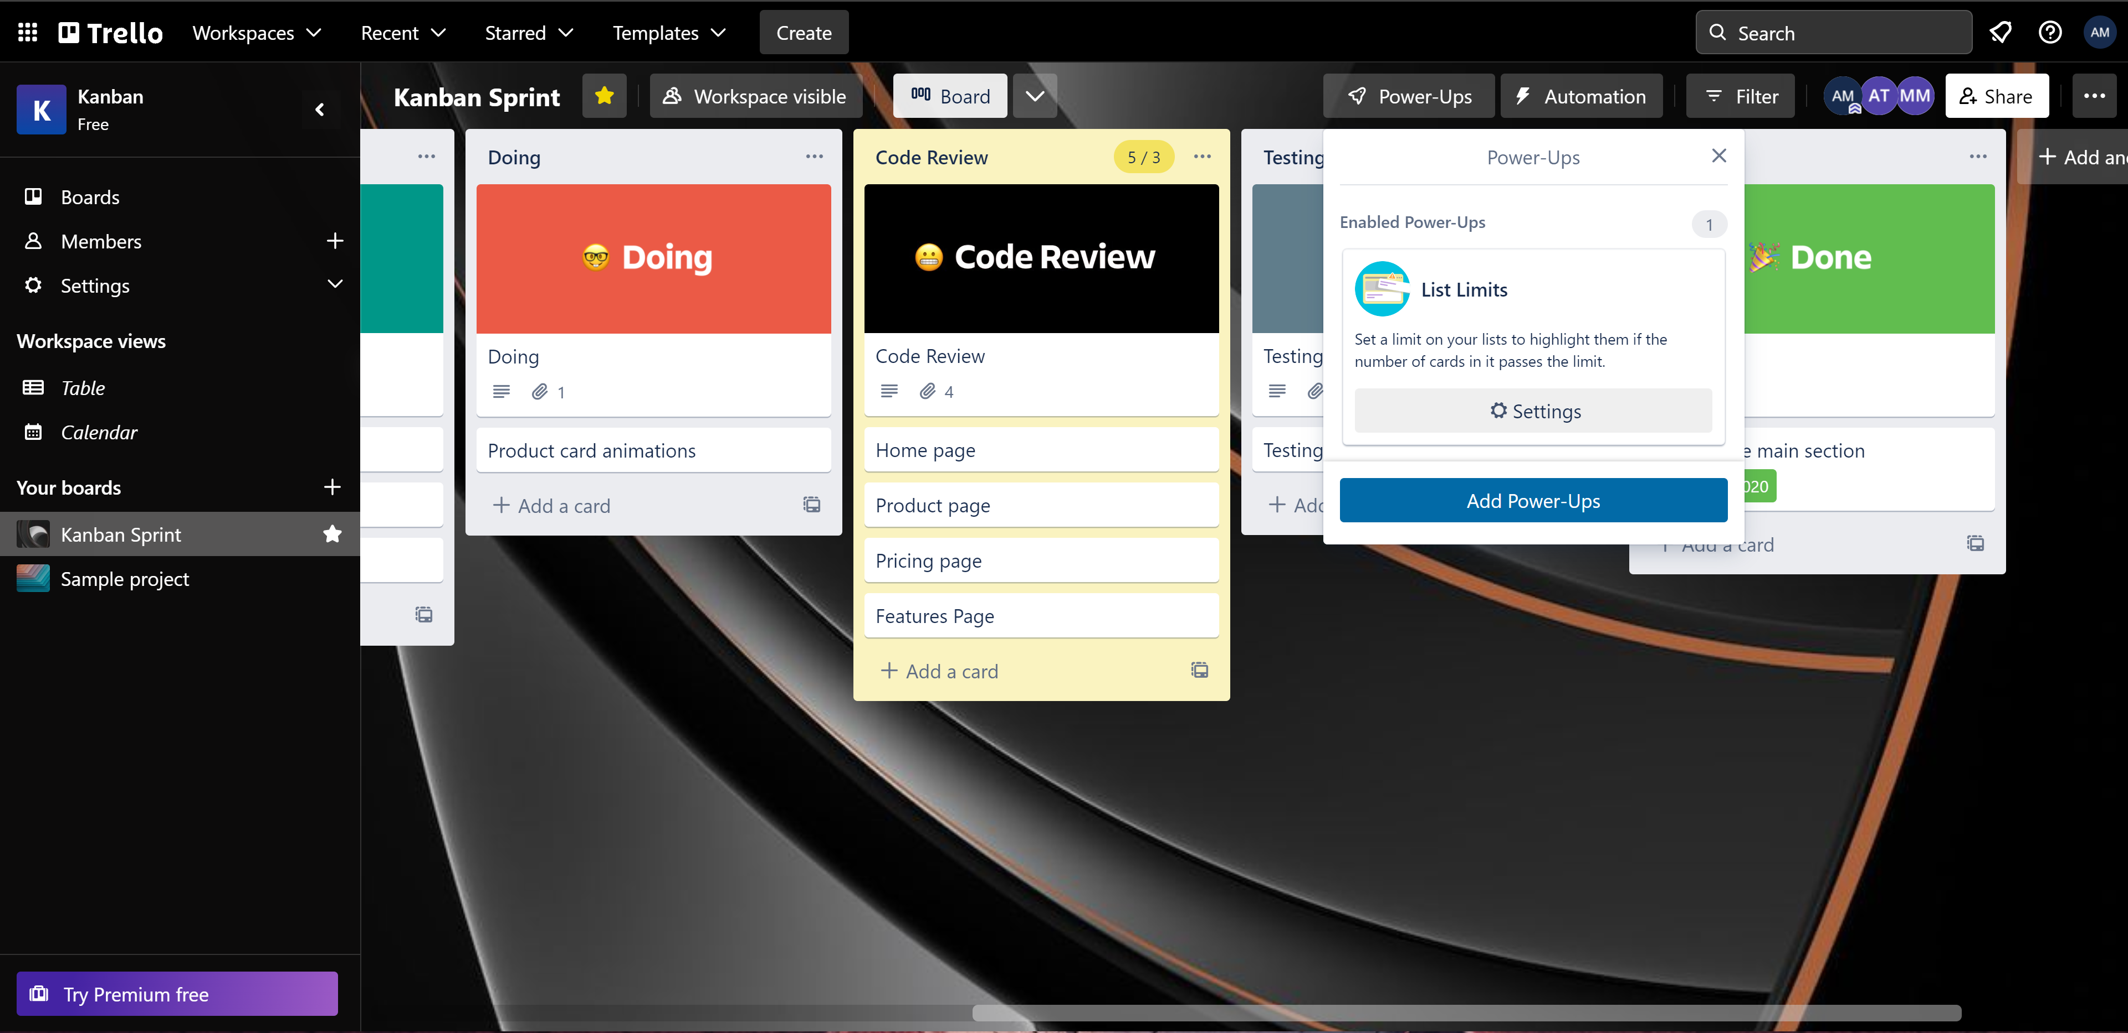
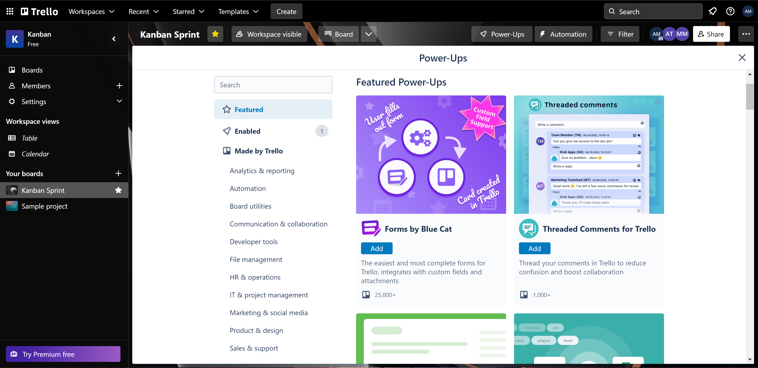
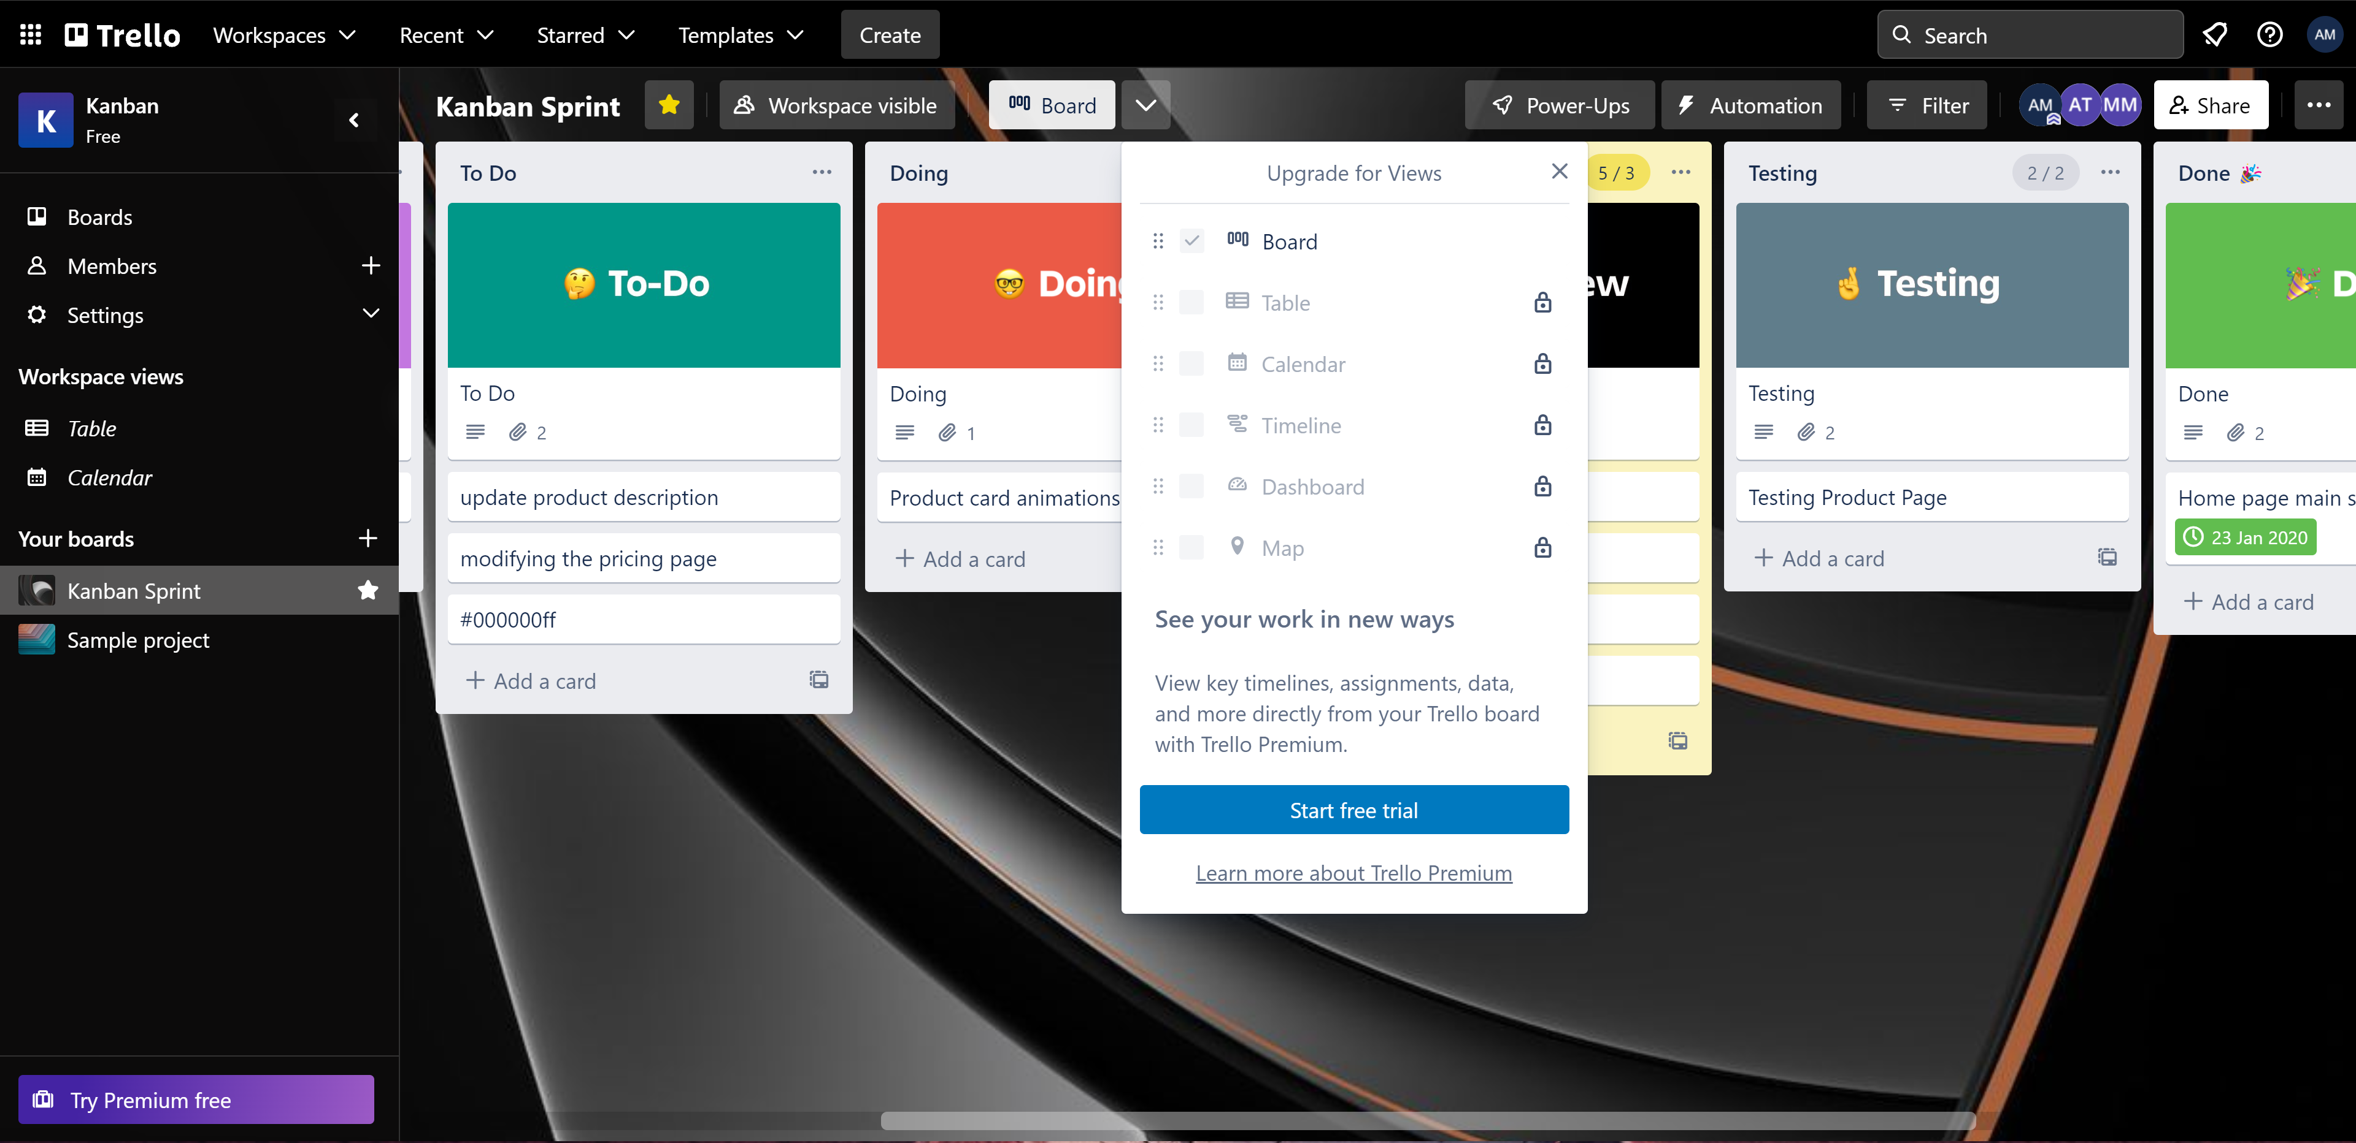
Trello Kanban Board
T

Slide 54
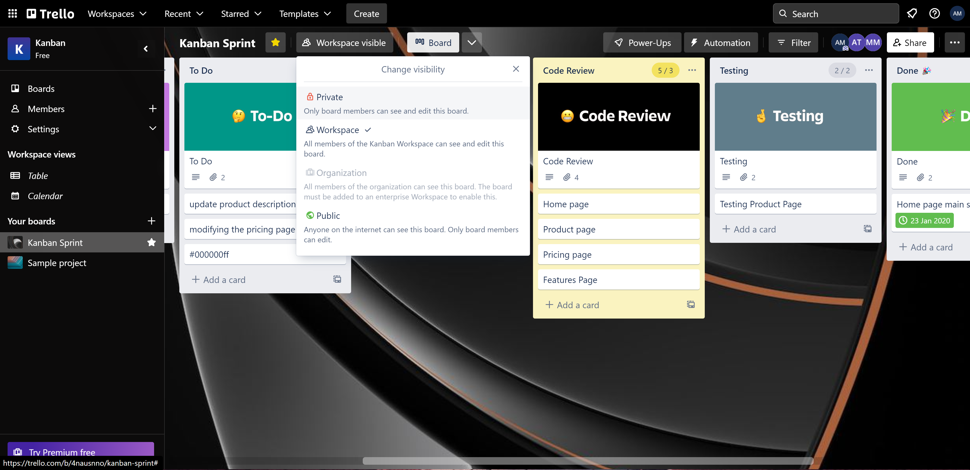
Trello Kanban Board visibility
T

Slide 55
Work-in-progress (WIP) limit:
T

Slide 56
Trello Power-ups
T

Slide 57
Trello Power-Ups
T

Slide 58
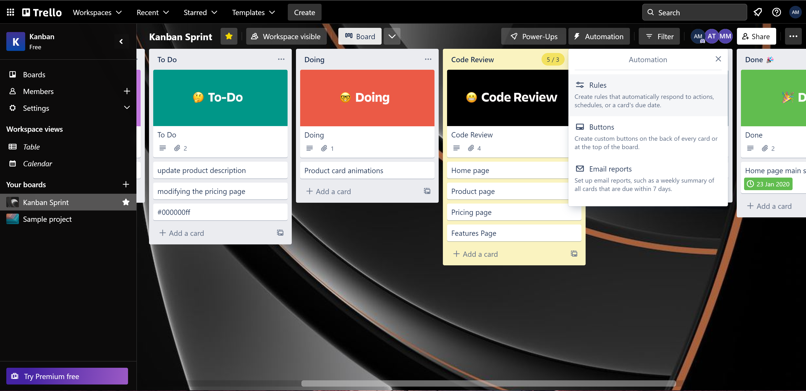
Trello Automation
T

Slide 59
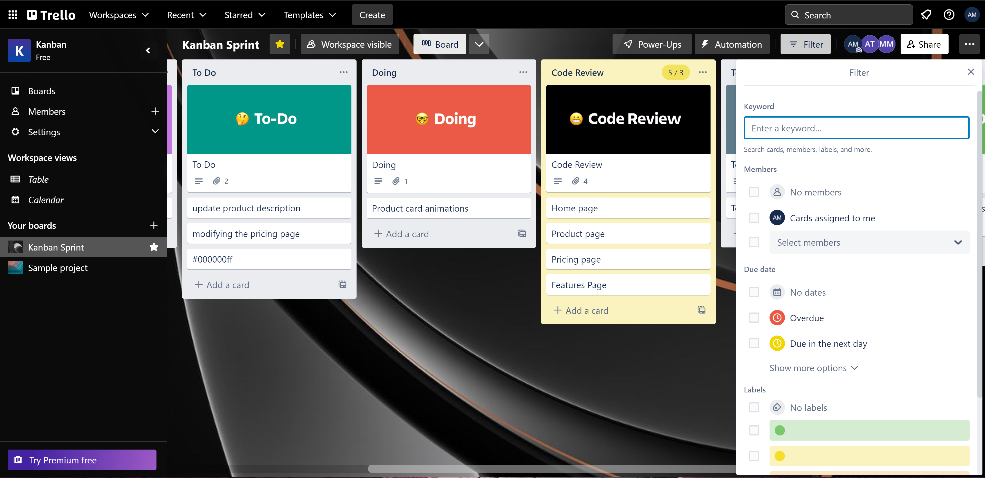
Trello Board Filter
T

Slide 60
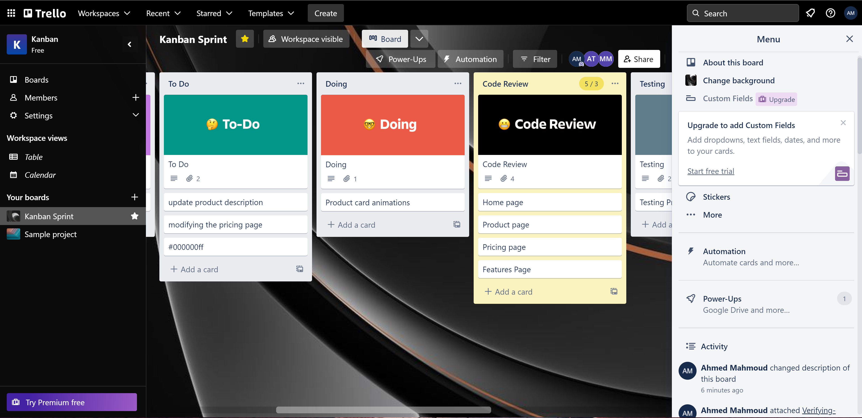
Trello Board Menu
T

Slide 61
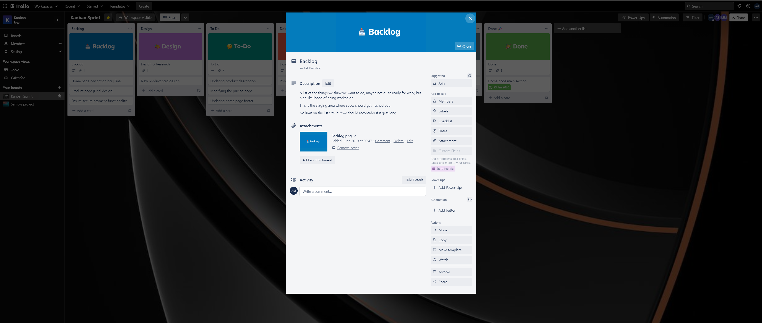
Trello Card Details
T

Slide 62
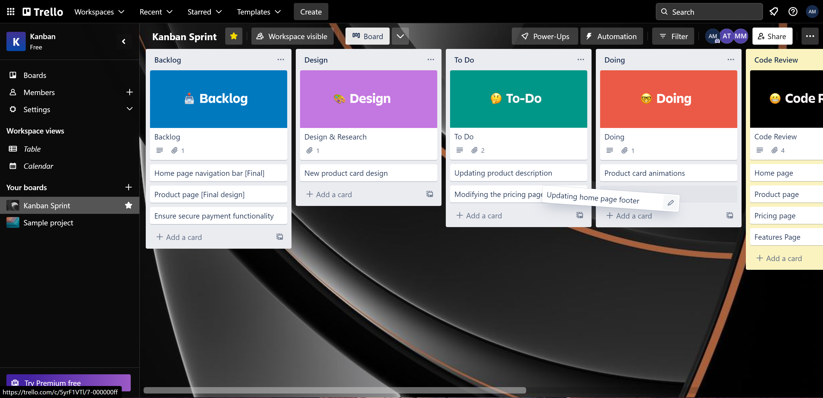
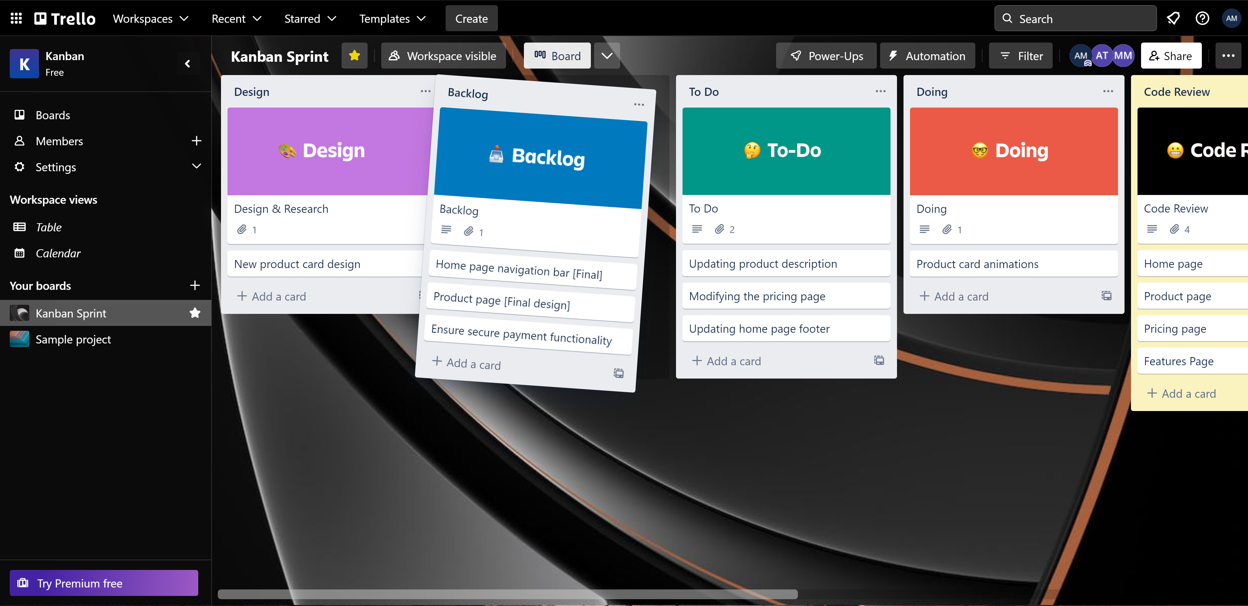
Trello Board list move
T

Slide 63
Trello Board Task assignment
T

Slide 64
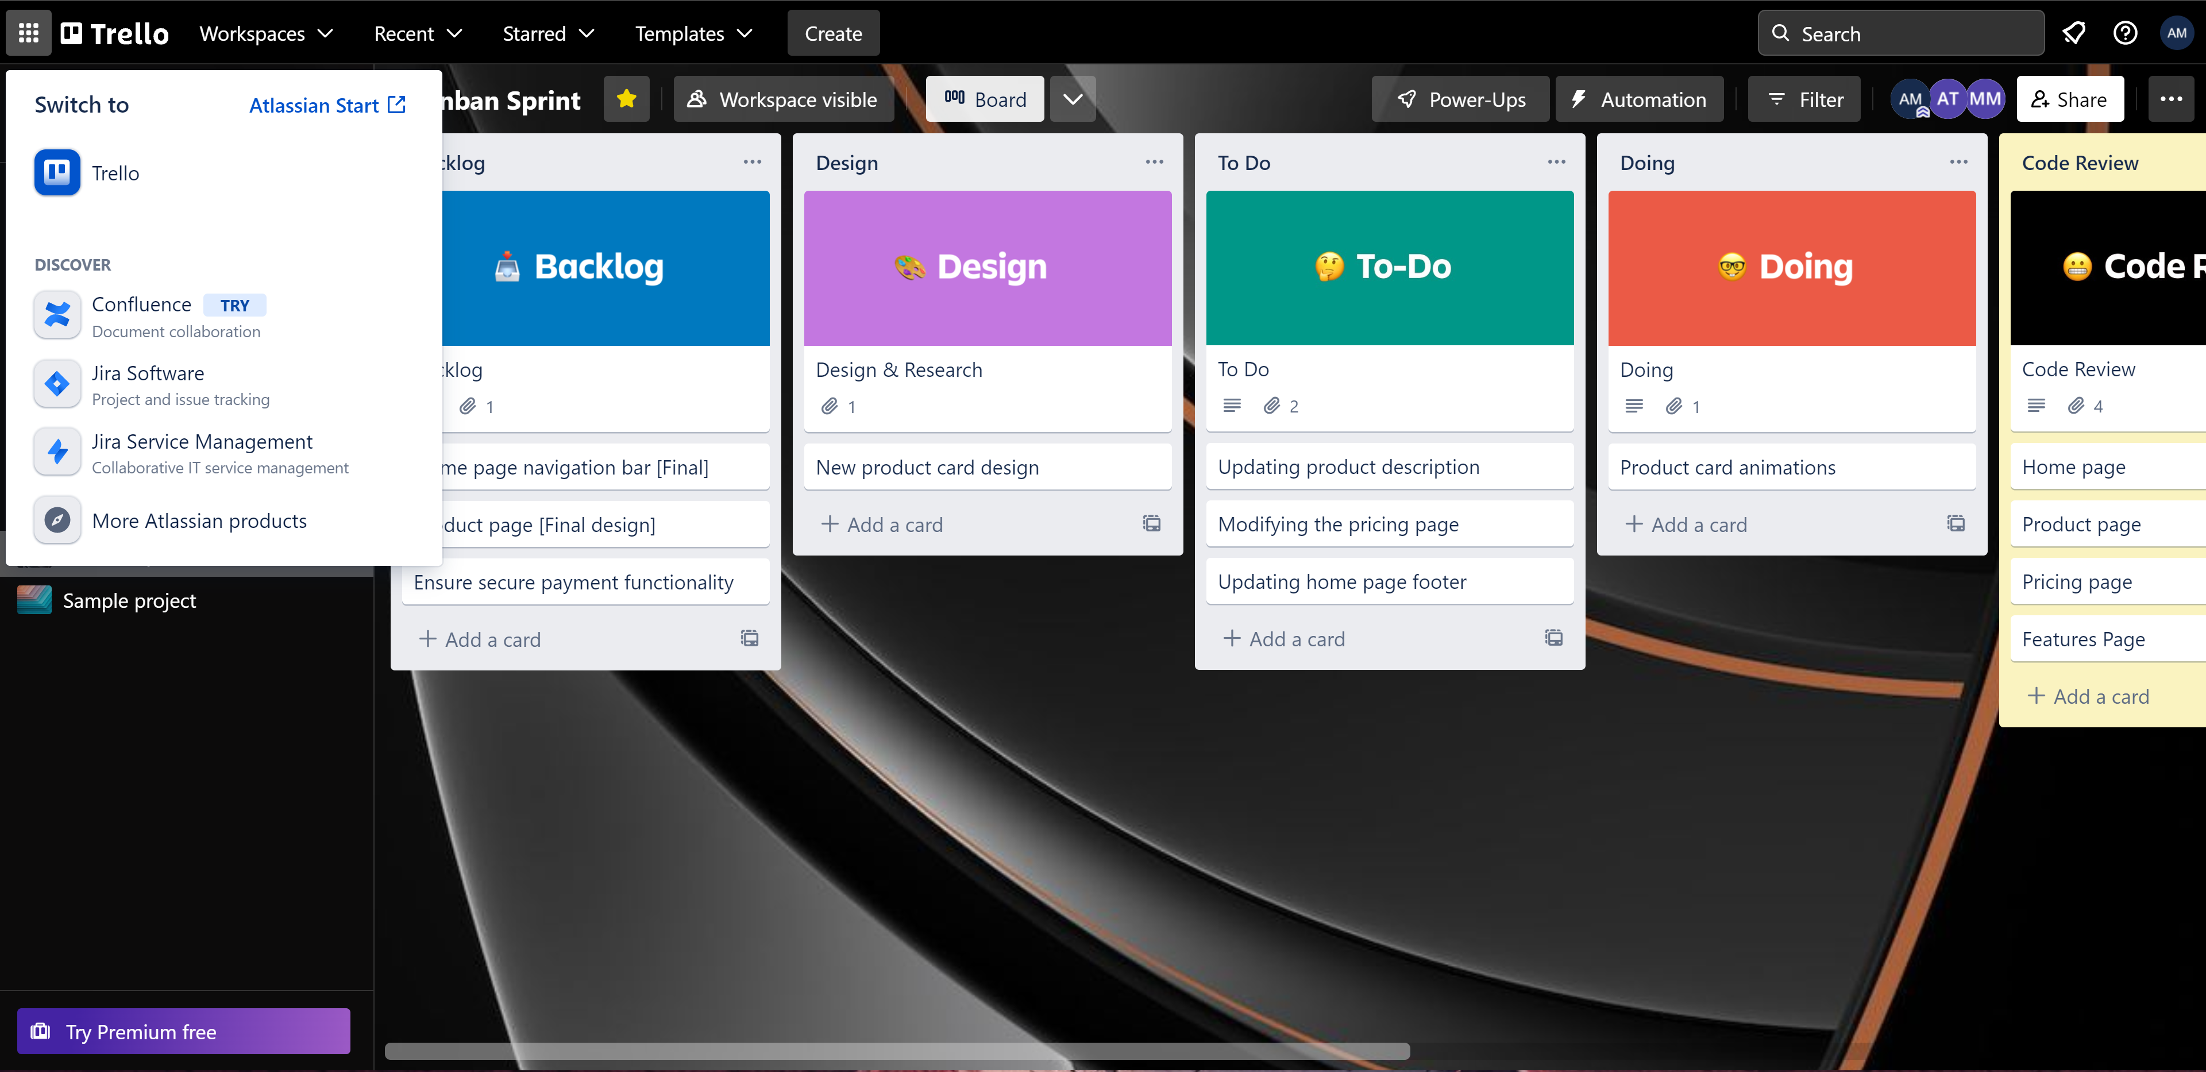
Atlassian products
T

Slide 65
THANKS!
Any questions?

